Slide 1
Process Synchronization
Background
The Critical-Section Problem
Synchronization Hardware
Semaphores
Classical Problems of Synchronization
Operating System Concepts

Slide 2
Background
A cooperating process is one that can affect or be affected by other processes executing in the system.
Concurrent access to shared data may result in data inconsistency.
In this lecture we will discuss various mechanisms to ensure the orderly execution of cooperating processes that share a logical address space, so that data consistency is maintained
Operating System Concepts

Slide 3
Background
The issues related to Inter process Communication are three.
1) How one process can pass information to another.
2) The second has to do with making sure two or more processes donot get into each other’s way when engaging in critical activities (suppose two processes each try to grab the last 1 MB of memory).
3) The third concerns proper sequencing when dependencies are present.
  if process A produces data and process B prints them, B has to wait until A has produced some data before starting to print
Operating System Concepts

Slide 4
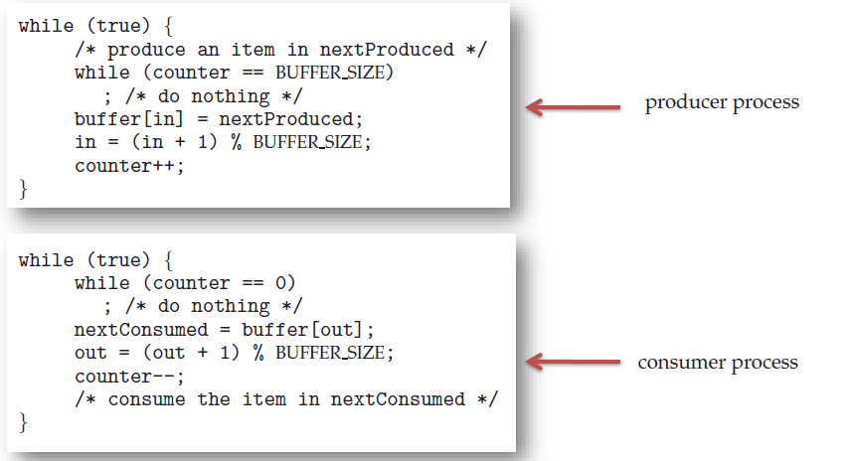
Race Condition
Consideration the bounded buffer for IPC.
Operating System Concepts

Slide 5
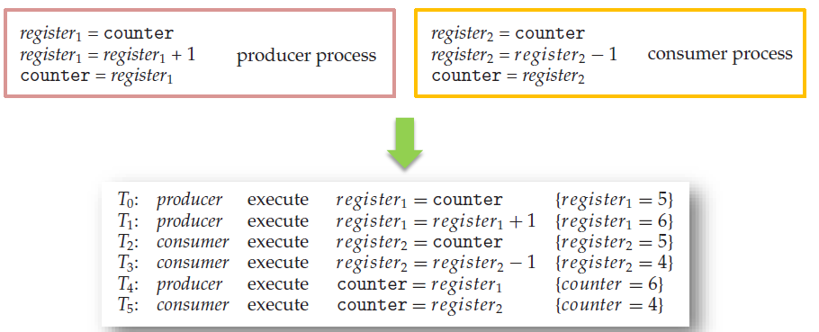
Race Condition
Suppose that the value of the variable counter is currently 5 and that the producer and consumer processes execute the statements “counter++” and “counter--” concurrently.
Operating System Concepts

Slide 6
Race Condition
A situation like this, where several processes access and manipulate the same data concurrently and the outcome of the execution depends on the particular order in which the access takes place, is called a race condition.
To guard against the race condition above, we need to ensure that only one process at a time can be manipulating the variable counter. To make such a guarantee, we require that the processes be synchronized in some way.
Operating System Concepts

Slide 7
The Critical-Section Problem
n processes all competing to use some shared data
Each process has a code segment, called critical section, in which the shared data is accessed.
Problem – ensure that when one process is executing in its critical section, no other process is allowed to execute in its critical section.
Structure of process P_{i}
repeat
entry section
critical section
exit section
reminder section
until false;
Operating System Concepts

Slide 8
Solution to Critical-Section Problem
1. Mutual Exclusion. If process Pi is executing in its critical section, then no other processes can be executing in their critical sections.
2. Progress. If no process is executing in its critical section and there exist some processes that wish to enter their critical section, then the selection of the processes that will enter the critical section next cannot be postponed indefinitely.
3. Bounded Waiting. A bound must exist on the number of times that other processes are allowed to enter their critical sections after a process has made a request to enter its critical section and before that request is granted.
  Assume that each process executes at a nonzero speed
  No assumption concerning relative speed of the n processes.
Operating System Concepts

Slide 9
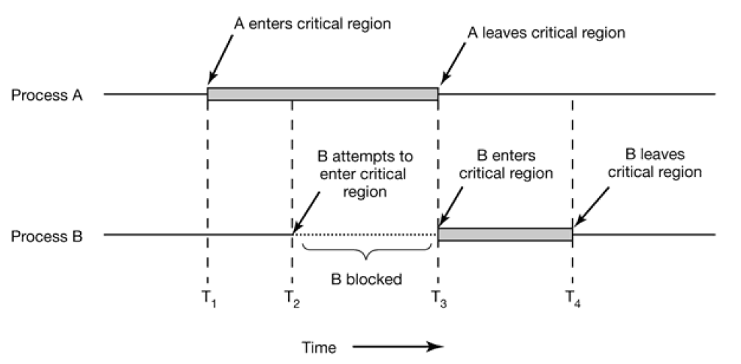
The Critical-Section Problem
Operating System Concepts

Slide 10
Initial Attempts to Solve Problem
Only 2 processes, P₀ and P₁
General structure of process P_{i} (other process P_{j})
repeat
entry section
critical section
exit section
reminder section
until false;
Processes may share some common variables to synchronize their actions.
Operating System Concepts

Slide 11
Algorithm 1: Strict Alternation
Shared variables:
  var turn: (0..1);
  initially turn = 0
  turn - i ⇒ P_{i} can enter its critical section
Process P_{i}
repeat
while turn ≠ i do no-op;
critical section
turn := j;
reminder section
until false;
Satisfies mutual exclusion, but not progress
Operating System Concepts

Slide 12
Algorithm 1: Strict Alternation
The integer variable turn , initially 0, keeps track of whose turn it is to enter the critical region.
Process 0 inspects turn , finds it to be 0, and enters its critical region. Process 1 also finds it to be 0 and therefore sits in a tight loop continually testing turn to see when it becomes 1.
Continuously testing a variable until some value appears is called busy waiting.
A lock that uses busy waiting is called a spin lock.
Strict alteration is also know as Mutex Lock
Operating System Concepts

Slide 13
Algorithm 1: Strict Alternation
When process 0 leaves the critical region, it sets turn to 1.
Suppose that process 1 finishes its critical region quickly.
Both processes are in their noncritical regions, with turn set to 0.
Now process 0 executes its whole loop quickly, exiting its critical region and setting turn to 1.
At this point turn is 1 and both processes are executing in their noncritical regions.
Operating System Concepts

Slide 14
Algorithm 1: Strict Alternation
Suddenly, process 0 finishes its noncritical region and goes back to the top of its loop.
Unfortunately, it is not permitted to enter its critical region now, because turn is 1 and process 1 is busy with its noncritical region.
It hangs in its while loop until process 1 sets turn to 0.
Taking turns is not a good idea when one of the processes is much slower than the other
Operating System Concepts

Slide 15
Algorithm 2: Lock Variables
Consider having a single, shared (lock) variable, initially 0. When a process wants to enter its critical region, it first tests the lock. If the lock is 0, the process sets it to 1 and enters the critical region.
If the lock is already 1, the process just waits until it becomes 0. Thus, a 0 means that no process is in its critical region, and a 1 means that some process is in its critical region.
Problem ?
Operating System Concepts

Slide 16
Algorithm 2: Lock Variables
Shared variables
  var flag: array [0..1] of boolean;
  initially flag [0] = flag [1] = false.
  flag [i] = true ⇒ P_{i} ready to enter its critical section
Process P_{i}
repeat
flag[i] := true;
while flag[j] do no-op;
critical section
flag [i] := false;
remainder section
until false;
Satisfies mutual exclusion, but not progress requirement.
Operating System Concepts

Slide 17
Algorithm 3: Peterson’s Solution
Good algorithmic description of solving the problem
Two process solution
Assume that the load and store machine-language instructions are atomic; that is, cannot be interrupted
The two processes share two variables:
  int turn;
  Boolean flag[2]
The variable turn indicates whose turn it is to enter the critical section
The flag array is used to indicate if a process is ready to enter the critical section. flag[i] = true implies that process P_{i} is ready!
Operating System Concepts

Slide 18
Algorithm 3: Peterson’s Solution
Combined shared variables of algorithms 1 and 2.
Process P_{i}
repeat
flag [i] := true;
turn := j;
while (flag [j] and turn = j) do no-op;
critical section
flag [i] := false;
remainder section
until false;
Meets all three requirements; solves the critical-section problem for two processes.
Operating System Concepts

Slide 19
Algorithm 3: Peterson’s Solution
Provable that the three CS requirement are met:
1. Mutual exclusion is preserved
P_{i} enters CS only if:
either flag[j] = false or turn = i
2. Progress requirement is satisfied
3. Bounded-waiting requirement is met
Operating System Concepts

Slide 20
Semaphore
Synchronization tool that provides more sophisticated ways (than Mutex locks) for process to synchronize their activities.
Semaphore S – integer variable
Can only be accessed via two indivisible (atomic) operations
  wait() and signal()
    Originally called P() and V()
Definition of the wait() operation
  wait(S) {
  while (S <= 0)
  ; // busy wait
  S--;
  }
Definition of the signal() operation
  signal(S) {
  S++;
  }
Operating System Concepts

Slide 21
Critical Section of n Processes
Shared variables
  var S: semaphore
  initially S = 1
Process P_{i}
repeat
wait(S);
critical section
signal(S);
remainder section
until false;
Operating System Concepts

Slide 22
Semaphore Implementation
Must guarantee that no two processes can execute the wait() and signal() on the same semaphore at the same time
Thus, the implementation becomes the critical section problem where the wait and signal code are placed in the critical section
  Could now have busy waiting in critical section implementation
    But implementation code is short
    Little busy waiting if critical section rarely occupied
Note that applications may spend lots of time in critical sections and therefore this is not a good solution

Slide 23
Semaphore Implementation with no Busy waiting
With each semaphore there is an associated waiting queue
Each entry in a waiting queue has two data items:
  value (of type integer)
  pointer to next record in the list
Two operations:
  block – place the process invoking the operation on the appropriate waiting queue
  wakeup – remove one of processes in the waiting queue and place it in the ready queue
typedef struct{
int value;
struct process *list;
} semaphore;

Slide 24
Implementation with no Busy waiting (Cont.)
wait(semaphore *S) {
S->value- -;
if (S->value < 0) {
add this process to S->list;
block();
}
}
signal(semaphore *S) {
S->value++;
if (S->value <= 0) {
remove a process P from S->list;
wakeup(P);
}
}

Slide 25
Two Types of Semaphores
Counting semaphore – integer value can range over an unrestricted domain.
Binary semaphore – integer value can range only between 0
and 1; can be simpler to implement.
Can implement a counting semaphore S as a binary semaphore.
Operating System Concepts

Slide 26
Other Application of Semaphore
Semaphore for Managing resources
Semaphore for Deciding sequence of execution.
Examples
Operating System Concepts

Slide 27
Problems with Semaphores
Incorrect use of semaphore operations:
  signal (mutex) …. wait (mutex)
  wait (mutex) … wait (mutex)
  Omitting of wait (mutex) or signal (mutex) (or both)
Deadlock and starvation are possible.

Slide 28
Synchronization Hardware
Many systems provide hardware support for implementing the critical section code.
Most solutions are based on idea of locking
  Protecting critical regions via locks
Uniprocessors – could disable interrupts
Operating System Concepts

Slide 29
Disabling Interrupts
Process disable all interrupts just after entering its critical region and re-enable them just before leaving it.
With interrupts disabled, no clock interrupts can occur.
The CPU is only switched from process to process as a result of clock or other interrupts.
Problems with this approach ?
  Generally too inefficient on multiprocessor systems
    Operating systems using this not broadly scalable
Solution:
  Modern machines provide special atomic hardware instructions
    Atomic = non-interruptible
  Either test memory word and set value
  Or swap contents of two memory words
Operating System Concepts

Slide 30
Synchronization Hardware
Test and modify the content of a word atomically.
function Test-and-Set (var target: boolean): boolean;
begin
Test-and-Set := target;
target := true;
end;
Operating System Concepts

Slide 31
Mutual Exclusion with Test-and-Set
Shared data: var lock: boolean (initially false)
Process P_{i}
repeat
while Test-and-Set (lock) do no-op;
critical section
lock := false;
remainder section
until false;
Operating System Concepts

Slide 32
Classical Problems of Synchronization
Classical problems used to test newly-proposed synchronization schemes
  Bounded-Buffer Problem
  Readers and Writers Problem
  Dining-Philosophers Problem

Slide 33
Bounded-Buffer Problem
n buffers, each can hold one item
Semaphore mutex initialized to the value 1
Semaphore full initialized to the value 0
Semaphore empty initialized to the value n

Slide 34
Bounded Buffer Problem (Cont.)
The structure of the producer process
do {
...
/* produce an item in next_produced */
...
wait(empty);
wait(mutex);
...
/* add next produced to the buffer */
...
signal(mutex);
signal(full);
} while (true);

Slide 35
Bounded Buffer Problem (Cont.)
The structure of the consumer process
Do {
wait(full);
wait(mutex);
...
/* remove an item from buffer to next_consumed */
...
signal(mutex);
signal(empty);
...
/* consume the item in next consumed */
...
} while (true);

Slide 36
Readers-Writers Problem
A data set is shared among a number of concurrent processes
  Readers – only read the data set; they do not perform any updates
  Writers – can both read and write
Problem – allow multiple readers to read at the same time
  Only one single writer can access the shared data at the same time
Several variations of how readers and writers are considered – all involve some form of priorities
Shared Data
  Data set
  Semaphore rw_mutex initialized to 1
  Semaphore mutex initialized to 1
  Integer read_count initialized to 0

Slide 37
Readers-Writers Problem (Cont.)
The structure of a writer process
do {
wait(rw_mutex);
...
/* writing is performed */
...
signal(rw_mutex);
} while (true);

Slide 38
Readers-Writers Problem (Cont.)
The structure of a reader process
do {
wait(mutex);
read_count++;
if (read_count == 1)
wait(rw_mutex);
signal(mutex);
...
/* reading is performed */
...
wait(mutex);
read count--;
if (read_count == 0)
signal(rw_mutex);
signal(mutex);
} while (true);

Slide 39
Readers-Writers Problem Variations
First variation – no reader kept waiting unless writer has permission to use shared object
Second variation – once writer is ready, it performs the write ASAP
Both may have starvation leading to even more variations
Problem is solved on some systems by kernel providing reader-writer locks

Slide 40

Dining-Philosophers Problem
Philosophers spend their lives alternating thinking and eating
Don’t interact with their neighbors, occasionally try to pick up 2 chopsticks (one at a time) to eat from bowl
  Need both to eat, then release both when done
In the case of 5 philosophers
  Shared data
    Bowl of rice (data set)
    Semaphore chopstick [5] initialized to 1

Slide 41
Dining-Philosophers Problem Algorithm
The structure of Philosopher i:
    do {
    wait (chopstick[i] );
    wait (chopStick[ (i + 1) % 5] );
    // eat
    signal (chopstick[i] );
    signal (chopstick[ (i + 1) % 5] );
    // think
    } while (TRUE);
What is the problem with this algorithm?

Slide 42
Dining-Philosophers Problem Algorithm (Cont.)
Deadlock handling
  Allow at most 4 philosophers to be sitting simultaneously at the table.
  Allow a philosopher to pick up the forks only if both are available (picking must be done in a critical section.
  Use an asymmetric solution -- an odd-numbered philosopher picks up first the left chopstick and then the right chopstick. Even-numbered philosopher picks up first the right chopstick and then the left chopstick.

